Slide 1

BUILDING A BETTER BOSS
CASE STUDY:
OXYGEN PROJECT
TEAM:
REKHA N C
R SOUMYA
SRI CHANDANA P
YOGITA RAIKAR

Slide 2
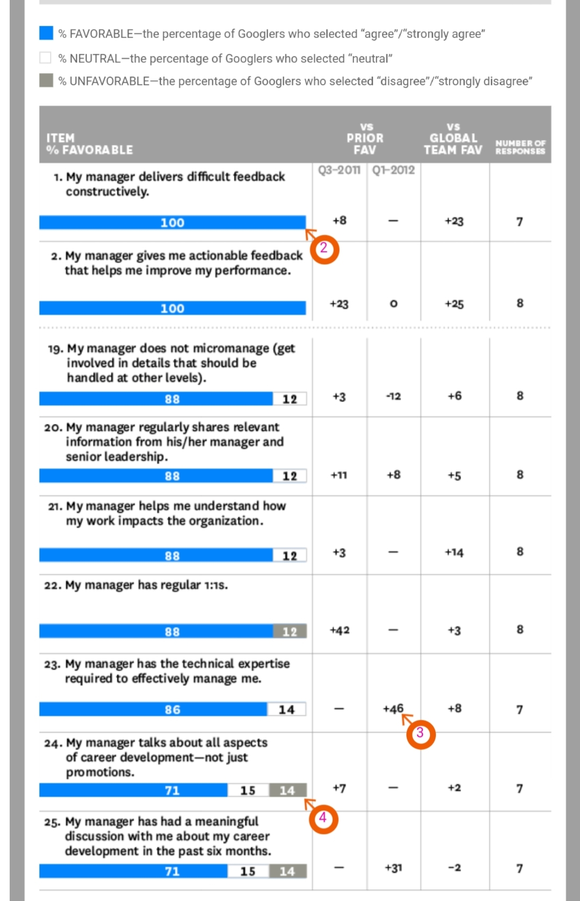
Project Oxygen : Do managers matter?
Background:
Engineers Myth at Google
Larry and Sergey experiment(2002)
Debunking Engineers Myth-2009 : Do Managers matter?
Research-1:
Exit Interviews, employee ratings and semi annual review
Identified high-scoring managers and low-scoring managers
Research-1 : Outcomes
High scoring manager – less turnover on their teams
Quality Managers ---> Happy Employee
Research-1 : Conclusion
Managers indeed mattered
Qualities of high scoring managers
Research-2:
Interviews, performance reviews, surveys, Great-Manager Award.
Research-2 : Outcomes
8 key behaviors of effective Managers
Putting result into practice
Assessment and training programs, UFS & TMS
Panel discussion and workshops for managers
‘Great Manager Award’

Slide 3
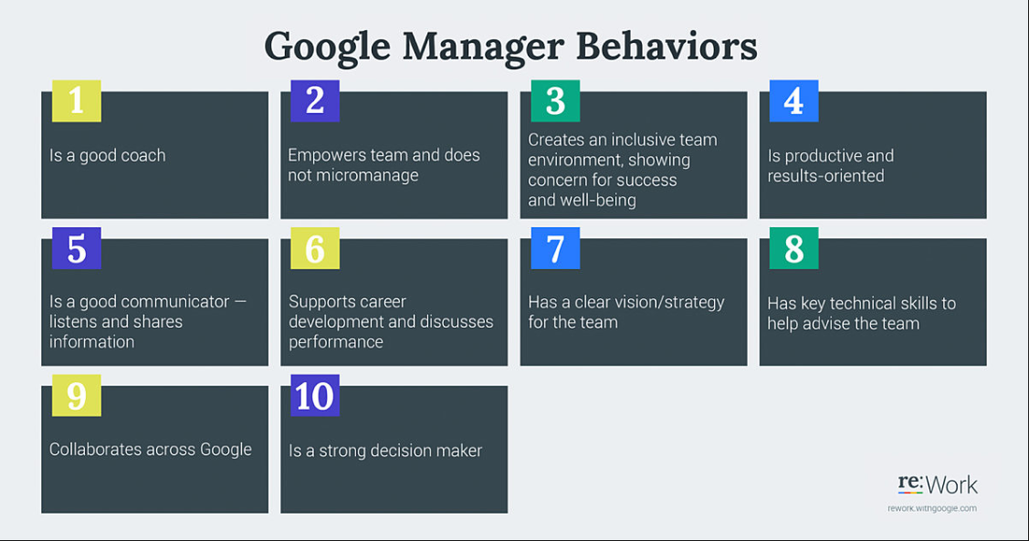

Slide 4
Other surveys:
Gallop’s 2017 State of workplace survey – Half of workers who quit their jobs say they left because of their managers.
Brian Kropp, group vice president of Gartner’s HR practice says, “Having bad manager, even up to five managers ago can still have a residual effect on performance today”.
In their defense, managers are juggling workloads that have increased over the past decade.
Kropp says, “Average middle manager has 50% more direct reports than a decade ago”.
According to Society for Human Resource Management survey(2018) – 37% of 1,285 managers believe its “extremely challenging” to manage the performance of others. And 38% believe its “extremely challenging” to develop the right culture for effective performance.
Conclusion:
Managers are the most important pillars of an organization.
Project Oxygen revealed the importance of soft skills managers.
Being good manager is much more than just delegating tasks and managing people’s time. Its about becoming a good leader, and paving way for others after you.

Slide 5
REFERENCE
https://hbr.org/2013/12/how-google-sold-its-engineers-on-management
https://in.search.yahoo.com/search?fr=mcafee&type=E211IN826G0&p=project+oxygen+by+google+ppt
https://in.search.yahoo.com/search?fr=mcafee&type=E211IN826G0&p=management
https://www.shrm.org/hr-today/news/hr-magazine/summer2019/pages/building-a-better-boss.aspx
https://rework.withgoogle.com/blog/the-evolution-of-project-oxygen/
https://www.youtube.com/watch?v=F4AQPOcqeZ4&feature=youtu.be

Slide 6
THANK YOU

